Slide 1
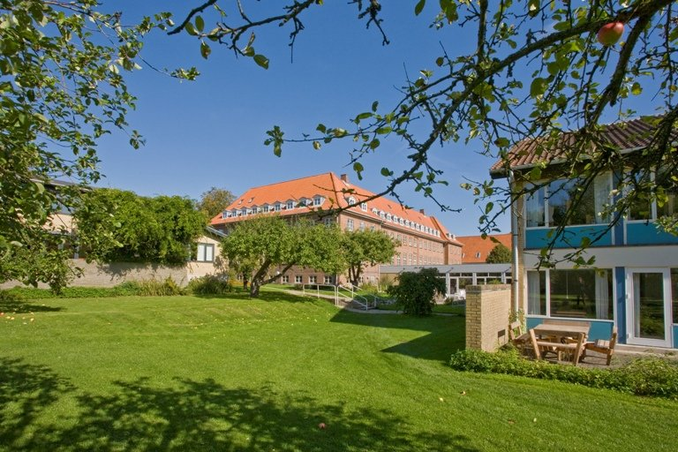
• “Leading Others” program - Rob Styler (:15)
• Responding to the need and the next leaders – Dan Sered (:30)
12:00 - 15:30. Lunch, rest / free time; 15:30- 16:00. Tea & coffee
16:00 - 17:30. Afternoon session. Specialized Ministries Bodil moderates
“Social Justice opportunities - as an outlet for Jewish evangelism outreaches” Amy Downey (:40)
“Working Together: A Smaller Mission Perspective.” Murray Tilles (:50)
Joseph Steinberg, respondent; discussion from the floor
18:00 – 18:45 Dinner
19:00 - 20:30 Evening session. Trends and Strategies
Wes Taber moderates: “New Jewish Demographic Trends and Changing Mission Strategies”. Panel interviews and questions from the floor (:70)
Rolf Heitmann: Europe; Herbby Geer: Strategies for reaching the minor diasporas (Brazil, etc.)
Rob Styler: Conference reflections (:15)
LCJE Fifth CEO Conference conclusion and closing prayer (:5) Jim
Friday, May 12
07:30 – 08:20 Breakfast; Departures
ICC meeting & working lunch: 10:00 to 17:00
Fifth LCJE CEO Conference
Emmaus Christian Centre
Haslev, Denmark
8-12 May 2017
Monday, May 8. Arrival and Welcome
14:00-16:00. Arrival at Emmaus Conference Centre
14:00-16:00 - Registration
15:45-16:45. Afternoon tea and coffee
16:45-18:00. Welcome and orientation (Emmaus conference staff); Program overview; conference purposes and expectations (Jim); Welcome to Denmark and introductions of attendees (Bodil); icebreaker.
18:00-18:45. Dinner
19:00-20:30. Evening session. Introduction to Denmark and Emmaus Conference Centre.
Arne (Danish music/hymns (:10)
“Vision of the Emmaus Conference Centre”- Grethe (:15)
“Past conferences held in Denmark on Jewish mission”- Bodil (:20) Where to go, and walks nearby - Bodil (:10) Scripture reading; Prayer in small groups – Dan moderates
Pray for goals of the conference; unity, personal prayer requests, etc. (:15-30)
End-of-day announcements and closing prayer – Jim
Participants
Armin Bachor Rolf Heitmann Joseph Steinberg
David Brickner Bernhard Heyl Rob Styler
Amy Downey Alex Jacob Sharon Styler
Linda Ekerhovd Jim Melnick Lori Taber
Herbby Geer Karen Melnick Wes Taber
Anne Geer Michael Mistretta Alana Tilles
Mitch Glaser Vanessa Mistretta Murray Tilles
Sasha Granovsky Morten Nielsen David Zadok
Lilian Granovsky Vladimir Pikman Eti Zadok
David Harley Martin Rösch Michael Zinn
Rosemary Harley Barry Rubin
Gary Hedrick Dan Sered
Marcia Hedrick Bodil Skjøtt

Slide 2
David Brickner, Mitch Glaser, Alex Jacob, Joseph Steinberg (:40). Discussion and questions (:20)
“Jewish mission responses to growing global anti-Semitism”
Mitch Glaser, Vladimir Pikman (:30)
Rob Styler: Reflections on the day (:10)
Wednesday, May 10.
07:30 – 08:20. Breakfast
08:30 – 10:00. Bible Reflection: “Dwelling in the Word.” David Harley, conference chaplain (Reading and listening to the Bible text, studying it alone and making personal observations (:15); sharing observations with table groups (:15); exposition on the passage (:30); applications shared in the group (:15); prayer for each other in the group (:15)
10:00 – 10:30. Morning tea & coffee
10:30 – 12:00. Morning session. Unity in Diversity. Jim moderates
“Seeking Unity in Diversity – Israeli-Palestinian Relations”
(Panel: David Zadok, Rolf Heitmann, Alex Jacob)
Questions and discussion from the floor
Bodil – Questions about “Jewish Walking Tour of Copenhagen” (:5)
12:15 – Depart by bus for Copenhagen – packed lunch on bus
13:30-16:00. Jewish Walking Tour of Copenhagen. Guided walking tour of Jewish Copenhagen. Presentation by Rabbi Yair Melchior, chief rabbi of Denmark, about the state of the Jewish community in Denmark today.
16:00 - 17:45 “Footloose in Copenhagen” - free time in the city
18:00 - 19:00. Bus trip return to Emmaus. 19:00 - 19:45. Dinner
20:00 – 20:45. Fellowship & informal discussions and optional videos
Thursday, May 11
07:30 – 08:20. Breakfast
08:30 – 09:45. Bible Reflection. “Dwelling in the Word.” David Harley, conference chaplain (similar pattern to Wednesday’s session)
09:45 – 10:00. Communion (led by Rev. Gary Hedrick)
10:00 – 10:30. Morning tea & coffee
10:30 – 12:00. Morning session. Mentorship and the Next Generation Jim moderates. “Writing your ministry will” practical exercise (:15) “Mentorship and Next Generation Strategies for succession and future leadership”
• “Preparing for a Successor” - Wes Taber (:15 min.)
• “Recruitment & Mentorship” Rolf Heitmann & Linda Ekerhovd (:15)
Tuesday, May 9.
07:30 – 08:20. Breakfast
08:30 – 09:30 Bible Reflection: “Dwelling in the Word.” David Harley, conference chaplain; Bodil explains process
Reading and listening to the Bible text, studying it alone and making personal observations; sharing observations with table groups; exposition on the passage; applications shared in the group; prayer for each other in the group.
09:30–10:30. Break: Tea, Coffee, free time for fellowship
10:30 – 11:40. Morning session. The Burdens of Leadership – Jim, moderator (:70)
Individuals or couples share their experiences, challenges and answers in this area; impact on family life, resources and victories. Break into small group discussions for comments, prayer and best ‘take-aways’; Close with any additional recommendations from groups and prayer.
11:40– 12:00. Break
12:00 – 15:00. Lunch, rest time and free time
15:00 - 15:30. Afternoon tea & coffee
15:30 - 17:00 Afternoon session. New Ministry Dreams and Partnerships. What are your dreams for new ministries or partnerships? Do you have new projects, methodologies, plans or opportunities where you are looking for or wanting to partner? - Dan moderates. CEOs are invited to share about desires for new ministry, initiatives, tools, resources or partnerships.
17:00 – 17:10. Break
17:10 – 17:45 LCJE Updates - Jim moderates -
LCJE archives update and how CEOs can help; LCJE website update; upcoming conferences: 11th LCJE European Conference (Berlin, 14-17 Aug 2017); LCJE Japan: Jewish Evangelism in East Asia (13-15 Nov. 2017); 11th International (Toronto, 11-16 Aug. 2019); LCJE Rules and Procedures - proposed rule changes
18:00 – 18:45 Dinner
19:00 – 20:45 Evening Session. Envisioning Our Future – Gary Hedrick – moderator. Four CEOs discuss their ministry vision for the future and leadership issues

